Slide 1
COMP 6246
Machine Learning Technologies
Convolutional Neural Network
Dr Mohammad Soorati
School of Electronics and Computer Science
University of Southampton

Slide 2
Motivation
DNN with fully connected layers:
  Can learn (almost) any data model
  If we do not need a connection -> set its weight close to 0
  It should be able to classify the images
Issues:
  Too many parameters
  For example, 100x100 pixels – 1st hidden layer with 1000 neurons -> 10 million connections
Convolutional layer:
  Motivated by nature
  Neurons in the convolutional layers are not connected to every pixel in the input image/previous layers, but only to some pixels

Slide 3
Motivation
If we input the entire raw image -> we loose the spatial information
0
0
0
0
0
0
0
0
1
1
0
0
0
1
1
1
1
0
0 | 0 | 0 | 0 | 0 | 0
0 | 0 | 1 | 1 | 0 | 0
0 | 1 | 1 | 1 | 1 | 0
0 | 1 | 1 | 1 | 1 | 0
0 | 0 | 1 | 1 | 0 | 0
0 | 0 | 0 | 0 | 0 | 0
…

Slide 4
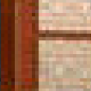

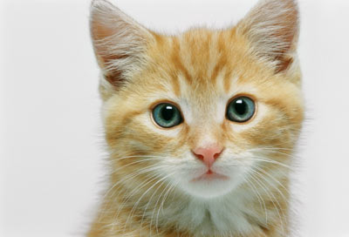









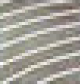
Motivation
[Zeiler, M. D., ECCV 2014]
……
……
……
……
……
……
Represented as pixels
……

Slide 5
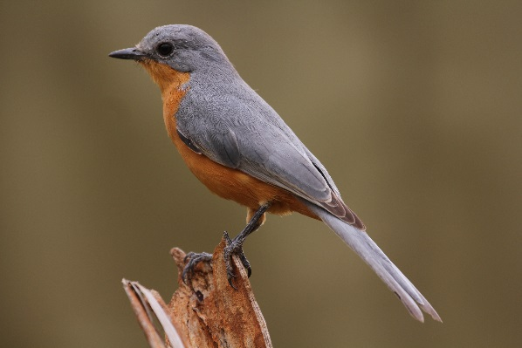
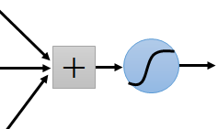
Why CNN for Image
Some patterns are much smaller than the whole image
A neuron does not have to see the whole image to discover the pattern.
Connecting to small region with less parameters
“beak” detector

Slide 6
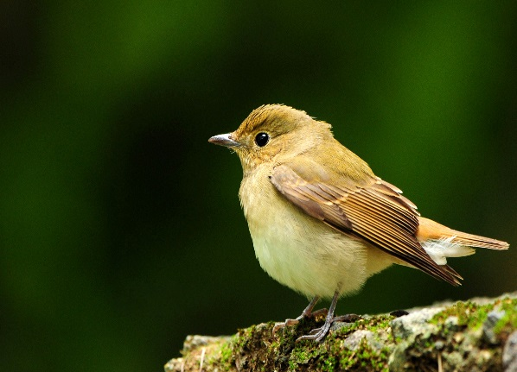
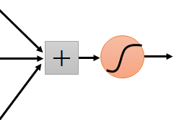
Why CNN for Image
The same patterns appear in different regions.
“upper-left beak” detector
Do almost the same thing
They can use the same set of parameters.
“middle beak” detector

Slide 7
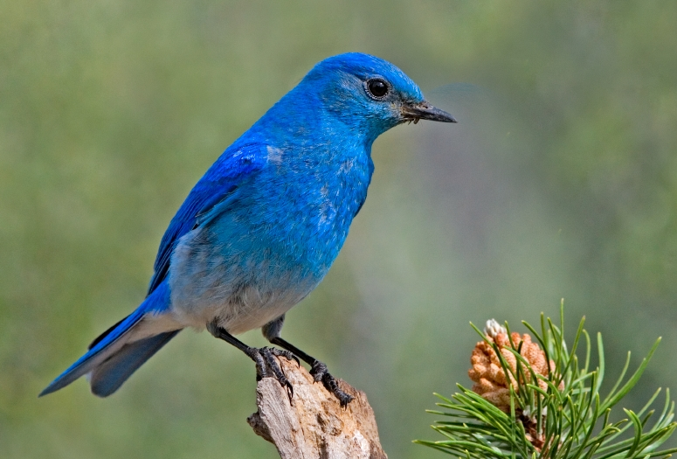

Why CNN for Image
Subsampling the pixels will not change the object
bird
bird
subsampling
We can subsample the pixels to make image smaller

Slide 8
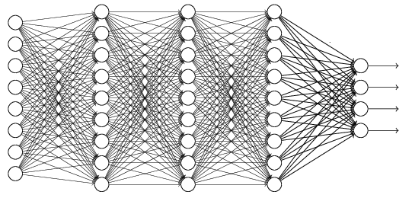
The whole CNN
cat dog ……
Convolution
Max Pooling
Can repeat many times
Fully Connected Feedforward network
Convolution
Max Pooling
Flatten

Slide 9
The whole CNN
Property 1
Some patterns are much smaller than the whole image
Convolution
Property 2
Max Pooling
The same patterns appear in different regions.
Can repeat many times
Property 3
Convolution
Subsampling the pixels will not change the object
Max Pooling
Flatten

Slide 10
The whole CNN
cat dog ……
Convolution
Max Pooling
Can repeat many times
Fully Connected Feedforward network
Convolution
Max Pooling
Flatten

Slide 11
CNN – Convolution
Those are the network parameters to be learned.
1 | -1 | -1
-1 | 1 | -1
-1 | -1 | 1
1 | 0 | 0 | 0 | 0 | 1
0 | 1 | 0 | 0 | 1 | 0
0 | 0 | 1 | 1 | 0 | 0
1 | 0 | 0 | 0 | 1 | 0
0 | 1 | 0 | 0 | 1 | 0
0 | 0 | 1 | 0 | 1 | 0
Filter 1
Matrix
-1 | 1 | -1
-1 | 1 | -1
-1 | 1 | -1
Filter 2
Matrix
……
6 x 6 image
Each filter detects a small pattern (3 x 3).
Property 1

Slide 12
CNN – Convolution
1 | -1 | -1
-1 | 1 | -1
-1 | -1 | 1
Filter 1
stride=1
Inner Product of Image x Filter
1 | 0 | 0 | 0 | 0 | 1
0 | 1 | 0 | 0 | 1 | 0
0 | 0 | 1 | 1 | 0 | 0
1 | 0 | 0 | 0 | 1 | 0
0 | 1 | 0 | 0 | 1 | 0
0 | 0 | 1 | 0 | 1 | 0
3
-1
6 x 6 image

Slide 13
CNN – Convolution
1 | -1 | -1
-1 | 1 | -1
-1 | -1 | 1
Filter 1
If stride=2
Inner Product of Image x Filter
1 | 0 | 0 | 0 | 0 | 1
0 | 1 | 0 | 0 | 1 | 0
0 | 0 | 1 | 1 | 0 | 0
1 | 0 | 0 | 0 | 1 | 0
0 | 1 | 0 | 0 | 1 | 0
0 | 0 | 1 | 0 | 1 | 0
3
-3
We set stride=1 below
6 x 6 image

Slide 14
CNN – Convolution
1 | -1 | -1
-1 | 1 | -1
-1 | -1 | 1
Filter 1
stride=1
1 | 0 | 0 | 0 | 0 | 1
0 | 1 | 0 | 0 | 1 | 0
0 | 0 | 1 | 1 | 0 | 0
1 | 0 | 0 | 0 | 1 | 0
0 | 1 | 0 | 0 | 1 | 0
0 | 0 | 1 | 0 | 1 | 0
3
-1
-3
-1
-3
1
0
-3
-3
-3
0
1
3
-2
-2
-1
6 x 6 image
Property 2

Slide 15
Example
Filter 1
-1 | 0 | 1
-1 | 0 | 1
-1 | 0 | 1
Input Image
1 | 1 | 1 | 0 | 0 | 0
1 | 1 | 1 | 0 | 0 | 0
1 | 1 | 1 | 0 | 0 | 0
1 | 1 | 1 | 0 | 0 | 0
1 | 1 | 1 | 0 | 0 | 0
1 | 1 | 1 | 0 | 0 | 0
0 | 0 | -3 | 0
0 | 0 | -3 | 0
0 | 0 | -3 | 0
0 | 0 | -3 | 0
Vertical edge detection kernel

Slide 16
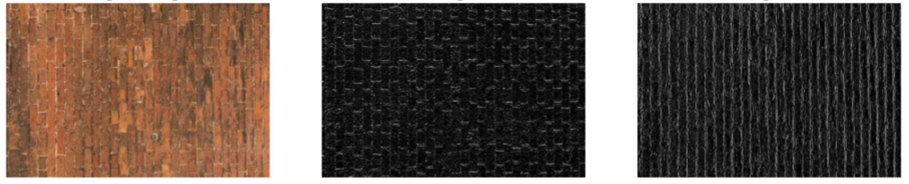
Edge Detection
? | ? | ?
? | ? | ?
? | ? | ?
Horizontal Edge Detection
Brick Wall
1 | 0 | -1
1 | 0 | -1
1 | 0 | -1
Vertical Edge Detection

Slide 17
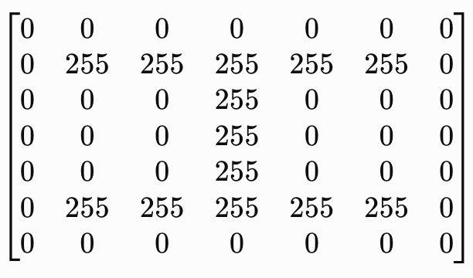
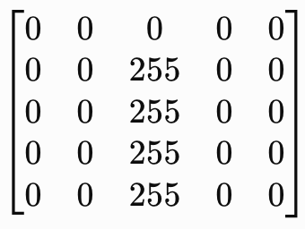
Example
Filter 1
-1 | 2 | -1
-1 | 2 | -1
-1 | 2 | -1
Input Image
Horizonal line detector kernel

Slide 18
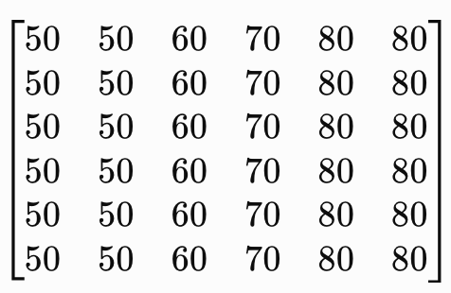
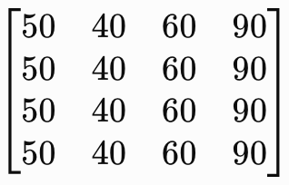
Example
Filter 1
0 | -1 | 0
-1 | 5 | -1
0 | -1 | 0
Input Image
Sharpening kernel

Slide 19
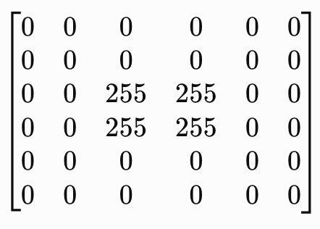
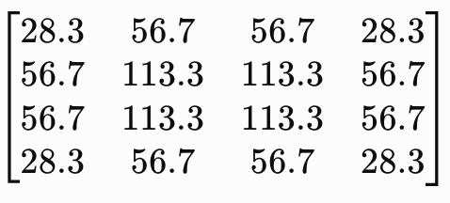
Example
Filter 1
1/9 | 1/9 | 1/9
1/9 | 1/9 | 1/9
1/9 | 1/9 | 1/9
Input Image
Blurring kernel

Slide 20
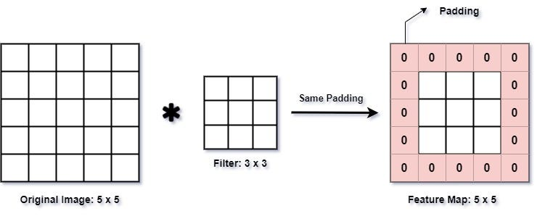
Padding
Adding extra pixels (usually zeros) around the border of an input image or feature map before applying a convolution operation to not shrink the image too quickly.
Example: padding = 1

Slide 21
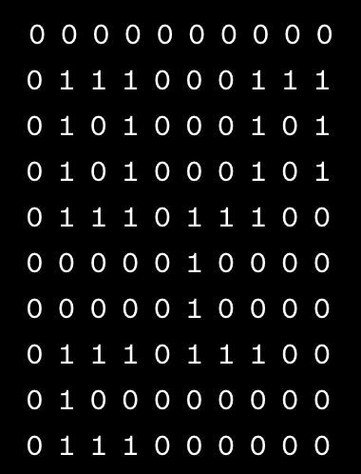
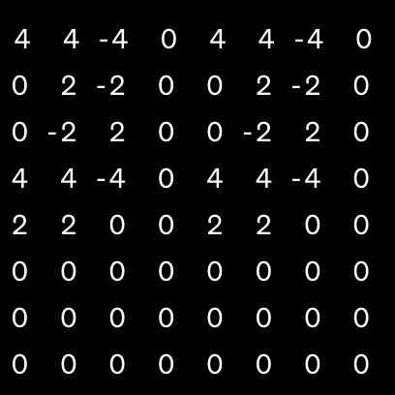
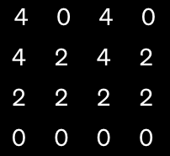
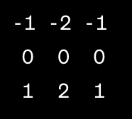
Example
Original Image
Horizonal Edge Detection Filter
After Convolution
After Pooling
(2x2, stride =2)
Demo:
https://poloclub.github.io/cnn-explainer/

Slide 22
CNN – Convolution
-1 | 1 | -1
-1 | 1 | -1
-1 | 1 | -1
Filter 2
stride=1
Do the same process for every filter
1 | 0 | 0 | 0 | 0 | 1
0 | 1 | 0 | 0 | 1 | 0
0 | 0 | 1 | 1 | 0 | 0
1 | 0 | 0 | 0 | 1 | 0
0 | 1 | 0 | 0 | 1 | 0
0 | 0 | 1 | 0 | 1 | 0
3
-1
-3
-1
-1
-1
-1
-1
-3
1
0
-3
-1
-1
-2
1
Feature
Map
-3
-3
0
1
-1
-1
-2
1
3
-2
-2
-1
6 x 6 image
-1
0
-4
3
4 x 4 image

Slide 23
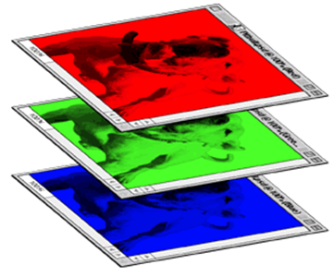
CNN – Colorful image
1 | -1 | -1
-1 | 1 | -1
-1 | -1 | 1
-1 | 1 | -1
-1 | 1 | -1
-1 | 1 | -1
1 | -1 | -1
-1 | 1 | -1
-1 | -1 | 1
-1 | 1 | -1
-1 | 1 | -1
-1 | 1 | -1
1 | -1 | -1
-1 | 1 | -1
-1 | -1 | 1
-1 | 1 | -1
-1 | 1 | -1
-1 | 1 | -1
Filter 1
Filter 2
Colorful image
1 | 0 | 0 | 0 | 0 | 1
0 | 1 | 0 | 0 | 1 | 0
0 | 0 | 1 | 1 | 0 | 0
1 | 0 | 0 | 0 | 1 | 0
0 | 1 | 0 | 0 | 1 | 0
0 | 0 | 1 | 0 | 1 | 0
1 | 0 | 0 | 0 | 0 | 1
0 | 1 | 0 | 0 | 1 | 0
0 | 0 | 1 | 1 | 0 | 0
1 | 0 | 0 | 0 | 1 | 0
0 | 1 | 0 | 0 | 1 | 0
0 | 0 | 1 | 0 | 1 | 0
1 | 0 | 0 | 0 | 0 | 1
0 | 1 | 0 | 0 | 1 | 0
0 | 0 | 1 | 1 | 0 | 0
1 | 0 | 0 | 0 | 1 | 0
0 | 1 | 0 | 0 | 1 | 0
0 | 0 | 1 | 0 | 1 | 0

Slide 24
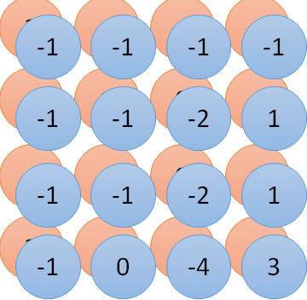

Convolution v.s. Fully Connected
1 | 0 | 0 | 0 | 0 | 1
0 | 1 | 0 | 0 | 1 | 0
0 | 0 | 1 | 1 | 0 | 0
1 | 0 | 0 | 0 | 1 | 0
0 | 1 | 0 | 0 | 1 | 0
0 | 0 | 1 | 0 | 1 | 0
1 | -1 | -1
-1 | 1 | -1
-1 | -1 | 1
-1 | 1 | -1
-1 | 1 | -1
-1 | 1 | -1
convolution
image
1 | 0 | 0 | 0 | 0 | 1
0 | 1 | 0 | 0 | 1 | 0
0 | 0 | 1 | 1 | 0 | 0
1 | 0 | 0 | 0 | 1 | 0
0 | 1 | 0 | 0 | 1 | 0
0 | 0 | 1 | 0 | 1 | 0
Fully-connected
……
……

Slide 25
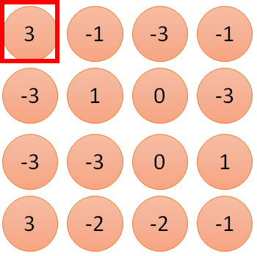
1 | -1 | -1
-1 | 1 | -1
-1 | -1 | 1
1:
1
Filter 1
2:
0
3:
0
3
4:
0
1 | 0 | 0 | 0 | 0 | 1
0 | 1 | 0 | 0 | 1 | 0
0 | 0 | 1 | 1 | 0 | 0
1 | 0 | 0 | 0 | 1 | 0
0 | 1 | 0 | 0 | 1 | 0
0 | 0 | 1 | 0 | 1 | 0
…
7:
0
8:
1
9:
0
10:
0
…
13:
0
6 x 6 image
14:
0
Less parameters!
15:
Only connect to 9 inputs, not fully connected
1
16:
1
…

Slide 26
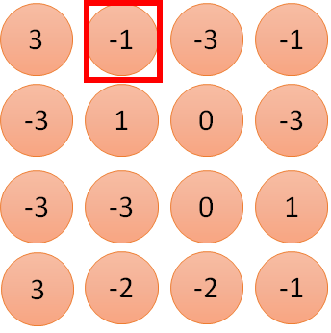
1 | -1 | -1
-1 | 1 | -1
-1 | -1 | 1
1:
1
Filter 1
2:
0
3:
0
3
4:
0
1 | 0 | 0 | 0 | 0 | 1
0 | 1 | 0 | 0 | 1 | 0
0 | 0 | 1 | 1 | 0 | 0
1 | 0 | 0 | 0 | 1 | 0
0 | 1 | 0 | 0 | 1 | 0
0 | 0 | 1 | 0 | 1 | 0
…
7:
0
8:
1
-1
9:
0
10:
0
…
13:
0
6 x 6 image
14:
0
Less parameters!
15:
1
16:
1
Shared weights
…

Slide 27
The whole CNN
cat dog ……
Convolution
Max Pooling
Can repeat many times
Fully Connected Feedforward network
Convolution
Max Pooling
Flatten

Slide 28
CNN – Max Pooling
1 | -1 | -1
-1 | 1 | -1
-1 | -1 | 1
-1 | 1 | -1
-1 | 1 | -1
-1 | 1 | -1
Filter 1
Filter 2
3
-1
-3
-1
-1
-1
-1
-1
-3
1
0
-3
-1
-1
-2
1
-3
-3
0
1
-1
-1
-2
1
3
-2
-2
-1
-1
0
-4
3

Slide 29
CNN – Max Pooling
New image
but smaller
1 | 0 | 0 | 0 | 0 | 1
0 | 1 | 0 | 0 | 1 | 0
0 | 0 | 1 | 1 | 0 | 0
1 | 0 | 0 | 0 | 1 | 0
0 | 1 | 0 | 0 | 1 | 0
0 | 0 | 1 | 0 | 1 | 0
Conv
3
0
-1
1
Max
Pooling
3
1
0
3
2 x 2 image
6 x 6 image
Each filter
is a channel

Slide 30
The whole CNN
3
0
-1
1
Convolution
3
1
0
3
Max Pooling
Can repeat many times
A new image
Convolution
Smaller than the original image
The number of the channel is the number of filters
Max Pooling

Slide 31
The whole CNN
cat dog ……
Convolution
Max Pooling
A new image
Fully Connected Feedforward network
Convolution
Max Pooling
A new image
Flatten

Slide 32
Flatten
3
0
1
3
0
-1
1
3
3
1
-1
0
3
Flatten
1
Fully Connected Feedforward network
0
3

Slide 33
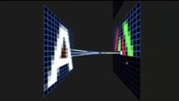
Alphabet Recognition with CNN

Slide 34
More about CCNs …

Slide 35

CNN in Keras
input
Convolution
1 | -1 | -1
-1 | 1 | -1
-1 | -1 | 1
-1 | 1 | -1
-1 | 1 | -1
-1 | 1 | -1
There are 25 3x3 filters.
……
Max Pooling
Input_shape = ( 1 , 28 , 28 )
1: black/white, 3: RGB
28 x 28 pixels
Convolution
3
-1
3
Max Pooling
-3
1

Slide 36
CNN in Keras
input
28 x 28
Convolution
26 x 26 x 25
Max Pooling
13 x 13 x 25
Convolution
11 x 11 x 50
Max Pooling
5 x 5 x 50

Slide 37
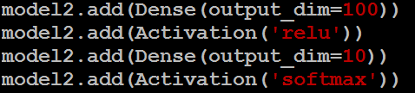
CNN in Keras
input
28 x 28
output
Convolution
26 x 26 x 25
Fully Connected Feedforward network
Max Pooling
13 x 13 x25
Convolution
11 x 11 x 50
Max Pooling
1250
5 x 5 x 50
Flatten

Slide 38
Exercise
What are the three properties a CNN aims to handle?
Given two matrices, how is convolution conducted?
Describe max pooling and average pooling
What is flatten operation?
Describe why there are much fewer parameters in a CNN?

